Slide 1
Convolutional Neural Network - I
Lecture 4
Part 1
Generative AI for Computer Vision

Slide 2
Content
Introduction to Convolutional Neural Network (CNN)
Typical CNN Architecture
  Convolution
  Pooling
  Local Contrast Normalization
CNN – For Image Recognition

Slide 3
Convolutional Neural Network
A Convolutional Neural Network (CNN) is a specialized type of neural network designed to automatically learn and extract meaningful features from input data, particularly images.
It consists of convolutional layers that apply multiple learnable filters (or kernels) across the input to identify fundamental patterns such as edges, textures, shapes, and other simple visual structures.
Unlike traditional neural networks, each neuron in a convolutional layer is connected only to a small local region (or patch) of the input, enabling the network to capture spatial relationships efficiently.
A key characteristic of CNNs is weight sharing, where the same filter (set of weights) is applied to different regions of the input. This significantly reduces the number of trainable parameters, lowers computational complexity, and improves the model's ability to generalize to unseen data.

Slide 4

Convolutional Neural Network (CNN)
A CNN is composed of several fundamental building blocks that work together to learn hierarchical representations of input data.
Convolutional layers extract local spatial features by applying learnable filters to the input, enabling the network to detect patterns such as edges, textures, and shapes.
Pooling layers reduce the spatial dimensions of feature maps while preserving the most important information, thereby improving computational efficiency and reducing overfitting.
Normalization and activation layers stabilize the training process and introduce nonlinearity, allowing the network to learn complex feature representations.
Fully connected layers integrate the extracted features to perform classification or other decision-making tasks.
Softmax layer converts the final outputs into class probabilities, enabling the prediction of the most likely class.
By combining these building blocks in different configurations, CNNs can be designed as either shallow or deep architectures to address a wide range of computer vision and pattern recognition tasks.
Convolution
Low Level Features
Non-linear Activation
Mid-Level Features
Normalization
High-Level Features
Pooling
Fully Connected layers
Softmax
Predictions

Slide 5

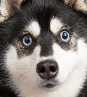
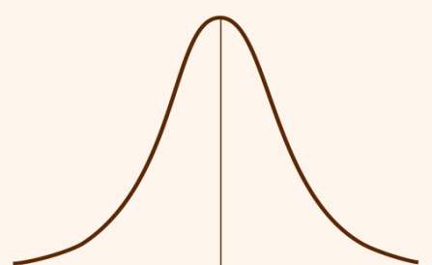
Convolutional Neural Network (CNN)
Convolution
Low Level Features
Feature Extraction
Input Layer
Non-linear Activation
Mid-Level Features
Hidden Layers
Normalization
High-Level Features
Subject to Network
Pooling
Fully Connected layers
Output Layer
Predictions
Predictions
Softmax
Conventional Machine Learning
Deep Learning Model
Convolutional Neural
Network
Predictions

Slide 6
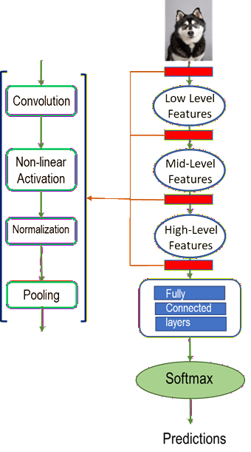
Convolutional Neural Network
Applications of Convolution Matrices :
Convolution kernels (or filters) are the fundamental components of Convolutional Neural Networks (CNNs) that enable automatic feature extraction from input data.
By sliding across the input image, each kernel learns to detect specific visual patterns and generates feature maps that represent the presence of these patterns.
Different kernels specialize in identifying different types of features, allowing CNNs to build increasingly complex representations through successive convolutional layers.
The major applications of convolution kernels include: Edge detection, Texture Analysis, Shape and Object feature extraction, Image classification, Object detection etc.
Convolution kernels serve as automatic feature extractors that progressively learn from simple low-level features to complex high-level semantic representations.

Slide 7
Convolution
Image Path
4
4
4
4
4
4
4
4
4
4
4
4
4
4
4
4
Searching for a Similar pattern
4
4
4
4
4
4
4
4
4
4
4
4
4
4
4
4
Convolution Kernel
1
1
1
0
0
0
0
0
0
0
0
0
0
0
0
0
0
0
0
0
0
0
0
0
0
0
0
0
0
0
-1
-1
-1
0
0
0
0
0
0
0
0
Resultant Pattern
0
0
0
0
0
0
0
0
0
0
0
0
12
12
12
12
12
12
12
12
12
12
12
12
0
0
0
0
0
0
0
0
0
0
0
0
$$4×1+4×1+4×1+4×0+4×0+4×0+4×(−1)+4×(−1)+4×(−1)=0$$

Slide 8
Convolution
Image Path
4
4
4
4
4
4
4
4
4
4
4
4
4
4
4
4
Searching for a Similar pattern
4
4
4
4
4
4
4
4
4
4
4
4
4
4
4
4
Convolution Kernel
1
1
1
0
0
0
0
0
0
0
0
0
0
0
0
0
0
0
0
0
0
0
0
0
0
0
0
0
0
0
-1
-1
-1
0
0
0
0
0
0
0
0
Resultant Pattern
0
0
0
0
0
0
0
0
0
0
0
0
12
12
12
12
12
12
12
12
12
12
12
12
0
0
0
0
0
0
0
0
0
0
0
0
$$4×1+4×1+4×1+4×0+4×0+4×0+4×(−1)+4×(−1)+4×(−1)=0$$

Slide 9
Convolution
Image Path
4
4
4
4
4
4
4
4
4
4
4
4
4
4
4
4
Searching for a Similar pattern
4
4
4
4
4
4
4
4
4
4
4
4
4
4
4
4
Convolution Kernel
1
1
1
0
0
0
0
0
0
0
0
0
0
0
0
0
0
0
0
0
0
0
0
0
0
0
0
0
0
0
-1
-1
-1
0
0
0
0
0
0
0
0
Resultant Pattern
0
0
0
0
0
0
0
0
0
0
0
0
12
12
12
12
12
12
12
12
12
12
12
12
0
0
0
0
0
0
0
0
0
0
0
0
$$4×1+4×1+4×1+4×0+4×0+4×0+4×(−1)+4×(−1)+4×(−1)=0$$

Slide 10
Convolution
Image Path
4
4
4
4
4
4
4
4
4
4
4
4
4
4
4
4
Searching for a Similar pattern
4
4
4
4
4
4
4
4
4
4
4
4
4
4
4
4
Convolution Kernel
1
1
1
0
0
0
0
0
0
0
0
0
0
0
0
0
0
0
0
0
0
0
0
0
0
0
0
0
0
0
-1
-1
-1
0
0
0
0
0
0
0
0
0
0
0
0
0
0
0
0
0
0
0
0
12
12
12
12
12
12
12
12
12
12
12
12
0
0
0
0
0
0
0
0
0
0
0
0
$$4×1+4×1+4×1+4×0+4×0+4×0+4×(−1)+4×(−1)+4×(−1)=0$$
Resultant Pattern

Slide 11
Convolution
Image Path
4
4
4
4
4
4
4
4
4
4
4
4
4
4
4
4
Searching for a Similar pattern
4
4
4
4
4
4
4
4
4
4
4
4
4
4
4
4
Convolution Kernel
1
1
1
0
0
0
0
0
0
0
0
0
0
0
0
0
0
0
0
0
0
0
0
0
0
0
0
0
0
0
-1
-1
-1
0
0
0
0
0
0
0
0
0
0
0
0
0
0
0
0
0
0
0
0
12
12
12
12
12
12
12
12
12
12
12
12
0
0
0
0
0
0
0
0
0
0
0
0
Resultant Pattern
$$4×1+4×1+4×1+4×0+4×0+4×0+4×(−1)+4×(−1)+4×(−1)=0$$

Slide 12
Convolution
Image Path
4
4
4
4
4
4
4
4
4
4
4
4
4
4
4
4
Searching for a Similar pattern
4
4
4
4
4
4
4
4
4
4
4
4
4
4
4
4
Convolution Kernel
1
1
1
0
0
0
0
0
0
0
0
0
0
0
0
0
0
0
0
0
0
0
0
0
0
0
0
0
0
0
-1
-1
-1
0
0
0
0
0
0
0
0
0
0
0
0
0
0
0
0
0
0
0
0
12
12
12
12
12
12
12
12
12
12
12
12
0
0
0
0
0
0
0
0
0
0
0
0
Resultant Pattern
$$4×1+4×1+4×1+4×0+4×0+4×0+4×(−1)+4×(−1)+4×(−1)=0$$

Slide 13
Convolution
Image Path
4
4
4
4
4
4
4
4
4
4
4
4
4
4
4
4
Searching for a Similar pattern
4
4
4
4
4
4
4
4
4
4
4
4
4
4
4
4
Convolution Kernel
0
0
0
0
0
0
0
0
1
1
1
0
0
0
0
0
0
0
0
0
0
0
0
0
0
0
0
0
0
0
-1
-1
-1
0
0
0
0
0
0
0
0
0
0
0
0
0
0
0
0
0
0
0
0
12
12
12
12
12
12
12
12
12
12
12
12
0
0
0
0
0
0
0
0
0
0
0
0
Resultant Pattern
$4×1+4×1+4×1+0×0+0×0+0×0+0×(−1)+0×(−1)+0×(−1)=$12

Slide 14
Convolution
Searching for a Similar pattern
Pattern : Horizontal Line
4
4
4
4
4
4
4
4
4
4
4
4
4
4
4
4
0
0
0
0
0
0
4
4
4
4
4
4
4
4
0
0
0
0
0
0
1
1
1
4
4
4
4
4
4
4
4
12
12
12
12
12
12
0
0
0
0
0
0
0
0
0
0
0
12
12
12
12
12
12
-1
-1
-1
0
0
0
0
0
0
0
0
0
0
0
0
0
0
Convolution Kernel
0
0
0
0
0
0
0
0
0
0
0
0
0
0
0
0
0
0
0
0
0
0
Resultant Pattern
Image Path

Slide 15
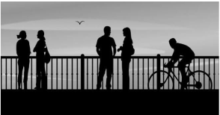
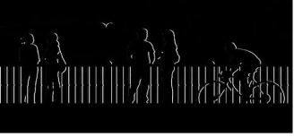
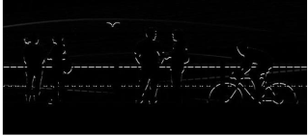
Convolution
Searching for Similar Pattern
Vertical Filtering
Horizontal Filtering
Vertical Edges
Horizontal Edges
Image Sources : Internet- Google

Slide 16
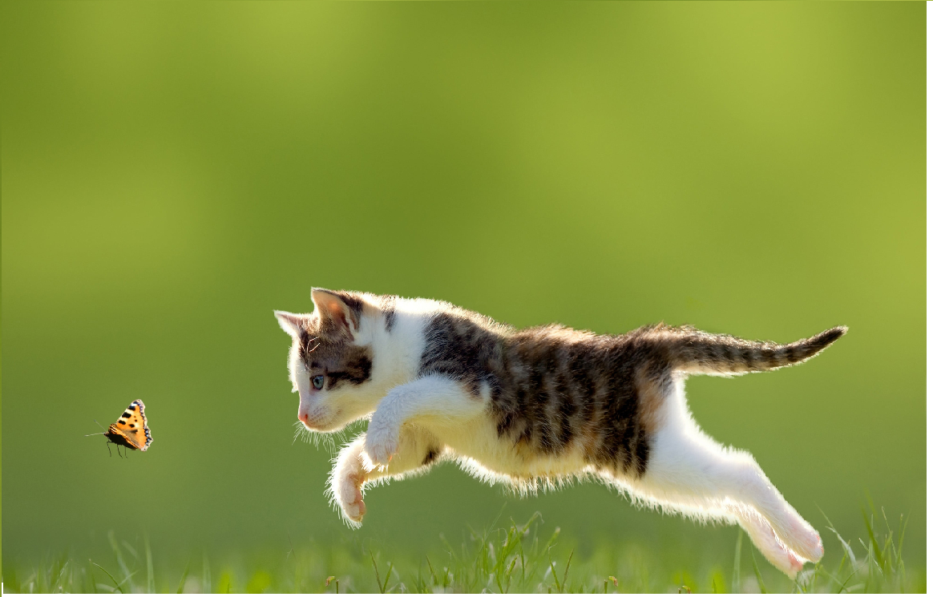
Convolution Layer
Key Observations:
Image statistics exhibit strong local consistency, meaning that pixels within small neighborhoods are highly correlated and often share similar visual characteristics.
Convolutional neural networks (CNNs) leverage this property by applying the same set of learnable filters across different spatial locations through a mechanism known as weight sharing.
This enables the network to detect the same features, such as edges, textures, and patterns, regardless of their position in the image.
In addition to improving feature extraction, weight sharing substantially reduces the number of trainable parameters, making the model more computationally efficient, less prone to overfitting, and better suited for processing high-dimensional image data.
Convolutional Neural Network (CNN):
In a Convolutional Neural Network (CNN), each hidden neuron is connected only to a small local region of the input, known as its receptive field, enabling the network to capture localized spatial features effectively.
The same set of learnable weights, referred to as filters or kernels, is applied across different spatial locations through a process called weight sharing.
Convolutional Neural Network (CNN):
This approach allows the network to detect similar patterns regardless of their position in the input while significantly reducing the number of trainable parameters.
Any neural network architecture that incorporates one or more convolutional layers is classified as a Convolutional Neural Network (CNN), making it particularly well suited for image analysis and other tasks involving spatially structured data.

Slide 17

Fully Connected Layers
32
32
$$W^{T}$$
1x3072
3072x10
1x10
3
Dot product of input (1x3072) and one row of W^{T}(3072x1)→ one scalar
(1x3072)x(3072x1)=(1)
1x3072
Fully Connected layer
Convolutional Neural Network by Justin Johnson: Michigan Online

Slide 18
How Convolution Work
32 X 32 X 32 image
32
28
5 X 5 X3 Filter
32
3
28
Convolve(slide) over all spatial locations
1
Activation Map
Convolutional Neural Network by Justin Johnson: Michigan Online

Slide 19
How Convolution Works
5 X 5 X 3
Convolution kernel
32
28
32 X 32 X 3 image patch
32
Convolve (slide) over all spatial location
28
3
1
Image Patch Size: NxNx3
Conv. Kernel Size: FxFx3
Stride: 1
Output size (K): [(N-F)/Stride] +1
Here, N=32, F=5, Stride=1
So, K=[(32-5)/1]+1=27+1=28
So, Activation Map: 28x28x1
28 X 28 X 1 Activation Map
Convolutional Neural Network by Justin Johnson: Michigan Online

Slide 20
Stacks of Convolution Layers
An input image patch is convolved with k different kernels (here, k=6), generating
Each activation map detects a specific pattern defined by its corresponding kernel. k corresponding activation (feature) maps.
5 X 5 X 3
Convolution Kernel
28
32 X 32 X 3 image patch
32
28 X 28 X 1 Activation Map
28
6 Different
Convolution Kernels
32
1
3
Convolutional Neural Network by Justin Johnson: Michigan Online

Slide 21
Convolution Layer
32
28
26
Six Conv
24
Conv
Ten Conv
Twelve Conv
3 X 5 X 5
Conv. Kernels
6 X 3 X 3
Conv. Kernels
10 X 3 X 3
Conv. Kernels
32
28
26
24
6
10
12
3
Input : 32 X 32 X 3 Image patch
Image Patch Size: NxNx3; Conv. Kernel Size: FxFx3; Stride: 1
Output size (K): [(N-F)/Stride] +1
Convolutional Neural Network by Justin Johnson: Michigan Online

Slide 22
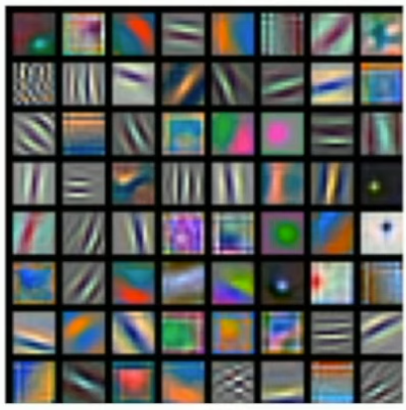
Activation Maps
32 X 32 X 3 image patch
5 X 5 X 3
Convolution kernel
32
28
32
28
Convolve (slide) over all spatial location
Activation Maps for AlexNet:
1st Hidden Layer 64 filters of 3 X11 X 11
3
1
28 X 28 X 1 Activation Map
Convolutional Neural Network by Justin Johnson: Michigan Online

Slide 23
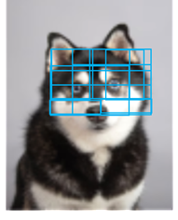
Pooling
While convolution determines whether specific patterns or features are present in the input, effective feature representation also requires a mechanism to emphasize the most important patterns at each spatial location.
Pooling fulfills this role by selecting the most prominent feature response, such as the maximum activation in a local neighborhood through max pooling.
By retaining only the most significant activations, pooling reduces the spatial resolution of the feature maps while preserving the most informative features.
This process not only decreases computational complexity but also enhances the network's robustness to small translations and distortions in the input data.

Slide 24
Different Types of Pooling
Max Pooling
Selects the maximum value from each pooling region.
Retains the strongest feature response.
Average Pooling
Computes the average value in each pooling region.
Preserves the overall feature information.
Why Pooling?
Reduces spatial dimensions
Speeds up computation
Preserves important features
Improves robustness to translation and noise
3
8
3
9
1
5
2
5
8
9
6
3
1
4
7
6
7
5
2
6
Max-Pooling
2
4
5
7
5
9
1
3
5
4
6
9
1
3
7
3
8
5
2
6
Average Pooling

Slide 25
Different Types of Pooling
Max Pooling
Selects the maximum value from each pooling region.
Retains the strongest feature response.
Average Pooling
Computes the average value in each pooling region.
Preserves the overall feature information.
Why Pooling?
Reduces spatial dimensions
Speeds up computation
Preserves important features
Improves robustness to translation and noise
3
8
3
9
1
5
2
5
8
9
6
3
1
4
7
6
7
5
2
6
Max-Pooling
2
4
5
7
5
9
1
3
5
4
6
9
1
3
7
3
8
5
2
6
Average Pooling

Slide 26
Different Types of Pooling
Max Pooling
Selects the maximum value from each pooling region.
Retains the strongest feature response.
Average Pooling
Computes the average value in each pooling region.
Preserves the overall feature information.
Why Pooling?
Reduces spatial dimensions
Speeds up computation
Preserves important features
Improves robustness to translation and noise
3
8
3
9
1
5
2
5
8
9
6
3
1
4
7
6
7
5
2
6
Max-Pooling
2
4
5
7
5
9
1
3
5
4
6
9
1
3
7
3
8
5
2
6
Average Pooling

Slide 27
Different Types of Pooling
Max Pooling
Selects the maximum value from each pooling region.
Retains the strongest feature response.
Average Pooling
Computes the average value in each pooling region.
Preserves the overall feature information.
Why Pooling?
Reduces spatial dimensions
Speeds up computation
Preserves important features
Improves robustness to translation and noise
3
8
3
9
1
5
2
5
8
9
6
3
1
4
7
6
7
5
2
6
Max-Pooling
2
4
5
7
5
9
1
3
5
4
6
9
1
3
7
3
8
5
2
6
Average Pooling

Slide 28
Different Types of Pooling
Max Pooling
Selects the maximum value from each pooling region.
Retains the strongest feature response.
Average Pooling
Computes the average value in each pooling region.
Preserves the overall feature information.
Why Pooling?
Reduces spatial dimensions
Speeds up computation
Preserves important features
Improves robustness to translation and noise
3
8
3
9
1
5
2
5
8
9
6
3
1
4
7
6
7
5
2
6
Max-Pooling
2
4
5
7
5
9
1
3
5
4
6
9
1
3
7
3
8
5
2
6
Average Pooling

Slide 29
Different Types of Pooling
Max Pooling
Selects the maximum value from each pooling region.
Retains the strongest feature response.
Average Pooling
Computes the average value in each pooling region.
Preserves the overall feature information.
Why Pooling?
Reduces spatial dimensions
Speeds up computation
Preserves important features
Improves robustness to translation and noise
3
8
3
9
1
5
2
5
8
9
6
3
1
4
7
6
7
5
2
6
Max-Pooling
2
4
5
7
5
9
1
3
5
4
6
9
1
3
7
3
8
5
2
6
Average Pooling

Slide 30
Different Types of Pooling
Max Pooling
Selects the maximum value from each pooling region.
Retains the strongest feature response.
Average Pooling
Computes the average value in each pooling region.
Preserves the overall feature information.
Why Pooling?
Reduces spatial dimensions
Speeds up computation
Preserves important features
Improves robustness to translation and noise
3
8
3
9
1
5
2
5
8
9
6
3
1
4
7
6
7
5
2
6
Max-Pooling
2
4
5
7
5
9
1
3
5
4
6
9
1
3
7
3
8
5
2
6
Average Pooling

Slide 31
Different Types of Pooling
Max Pooling
Selects the maximum value from each pooling region.
Retains the strongest feature response.
Average Pooling
Computes the average value in each pooling region.
Preserves the overall feature information.
Why Pooling?
Reduces spatial dimensions
Speeds up computation
Preserves important features
Improves robustness to translation and noise
3
8
3
9
1
5
2
5
8
9
6
3
1
4
7
6
7
5
2
6
Max-Pooling
2
4
5
7
5
9
1
3
5
4
6
9
1
3
7
3
8
5
2
6
Average Pooling

Slide 32
Contrast Normalization
Contrast Normalization (CN) is a technique in CNNs that enhances feature detection by normalizing pixel intensities or feature activations based on local contrast. It highlights important features, suppresses uniform high-intensity regions, and improves robustness to illumination variations.
A common approach is Local Contrast Normalization (LCN), which uses neighboring pixels for local subtraction and normalization.

Slide 33
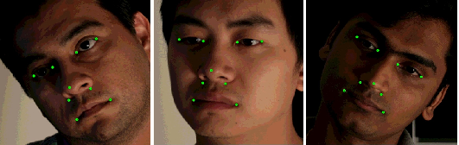
Local Contrast Normalization
Contrast variations change pixel intensities and convolution responses. Contrast normalization reduces their impact, enabling more robust and consistent feature detection.
If the contrast of an image changes, the CNN output may vary because filter responses change. Contrast normalization addresses this by:
Adjusting pixel intensities to balance local brightness and contrast.
Reducing the effect of illumination variations.
Enhancing structural details in the image.
Improving feature consistency across different regions.
Image Source : Images of faces in different head poses with the nine reference points (facial landmarks) superimposed. The instances are probe images (2D data) from dataset UHDB11

Slide 34
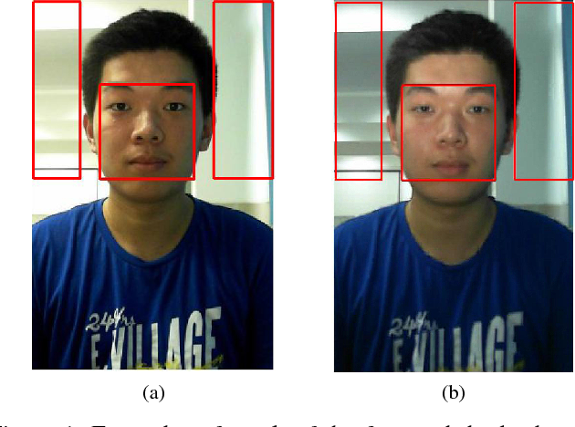
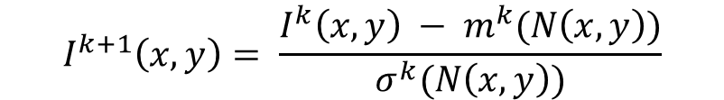
Local Contrast Normalization
Local Contrast Normalization (LCN) reduces the effects of illumination variations by normalizing feature activations with respect to their local neighborhood.
This process scales feature values based on the statistics of surrounding activations, making the network less sensitive to local changes in lighting and contrast.
As a result, LCN enhances edge and texture information while suppressing irrelevant intensity variations, allowing more discriminative features to be learned.
By improving the consistency and robustness of feature representations, Local Contrast Normalization contributes to better generalization and overall performance in image recognition and other computer vision tasks.
$$I^{k+1}\left(x,y\right)= \frac{I^{k}\left(x,y\right) − m^{k}(N\left(x,y\right))}{σ^{k}(N\left(x,y\right))}$$
Image source : Examples of result of the face and the background extraction. The center rectangle and the rectangles on both sides of each image are the face and the background region: (a) Non-flash image; (b) Flash image.

Slide 35
CNN Processing Stages
A Convolutional Neural Network (CNN) processes input data through a sequence of specialized stages that progressively extract and refine meaningful features.
The process begins with the convolution stage, where learnable filters are applied to the input to detect local patterns such as edges, textures, and shapes.
The resulting feature maps are then passed through an activation function, such as Rectified Linear Unit (ReLU) or Sigmoid, which introduces non-linearity and enables the network to learn complex relationships within the data.
Next, normalization is performed to standardize feature activations, improving training stability, accelerating convergence, and enhancing the model's ability to generalize to unseen data.
Finally, the pooling stage downsamples the feature maps by retaining the most significant activations, thereby reducing spatial dimensions, lowering computational complexity, and improving the network's robustness to small translations and distortions in the input.

Slide 36
CNN – The Whole Picture
A standard CNN architecture consists of convolutional layers that extract features, activation functions (e.g., ReLU) that introduce non-linearity, optional normalization layers that stabilize training and improve feature consistency, and pooling layers that reduce spatial dimensions while preserving important information. These components work together to progressively learn hierarchical feature representations. The extracted features are then passed to one or more fully connected layers, and a final output layer (e.g., Softmax for classification) produces the predicted class probabilities.
96%
152
60M
ImageNet Top-5
ResNet Layers
Parameters
Modern CNN accuracy on classification benchmarks
Depth of breakthrough architectures like ResNet-152
Typical parameter count in large-scale CNNs

Slide 37
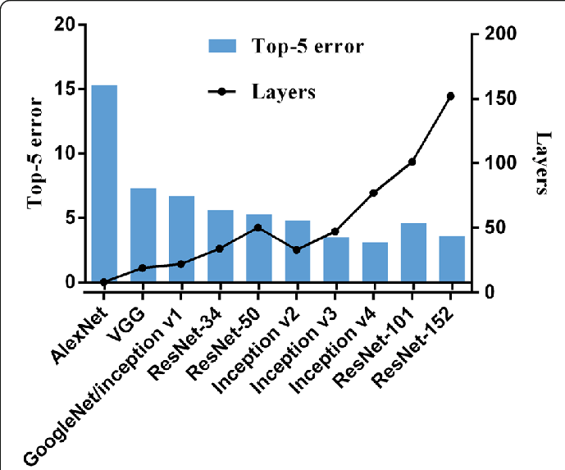
CNNs for Image Recognition
Object Detection : Generate region proposals to localize objects, then classify each proposed region using dedicated classification heads.
Semantic Segmentation : Assign class labels to every pixel for dense prediction tasks such as scene understanding.
Image Classification : Assign a single class label to an entire image—the foundation of many computer vision applications
Image Source : Tong, Yan & Lu, Wei & Yu, Yue & Shen, Yin. (2020). Application of machine learning in ophthalmic imaging modalities. Eye and Vision. 7. 10.1186/s40662-020-00183-6.

Slide 38
Summary
Introduction to Convolutional Neuron Network (CNN)
Typical CNN Architecture
  Convolution
  Pooling
  Local Contrast Normalization
CNN – for Image Recognition

Slide 39
CNN Model Architectures
Next
Lecture 4: Part II
Generative AI for Computer Vision

